Slide 1

CS 131
Jovin Valdez

Slide 2
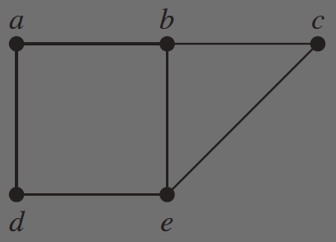
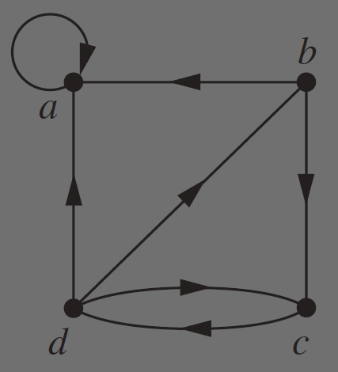
Graph Theory
Graph theory helps us visualize and analyze the relationships between things.
Node/
Vertex
Edge

Slide 3
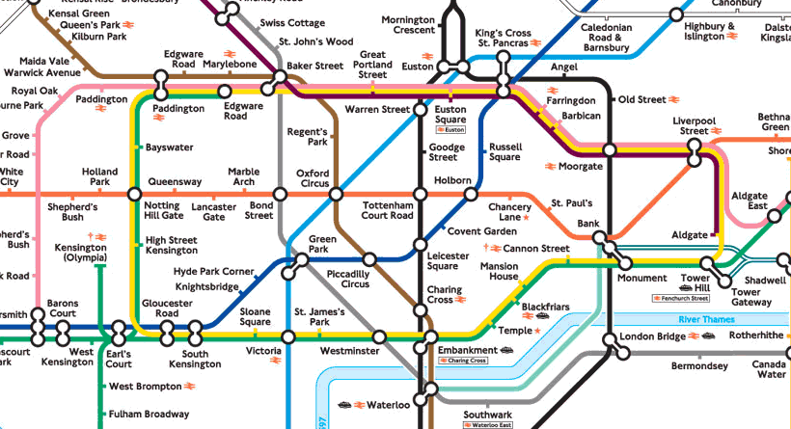

Graph Theory
Applications
Graph Models help us:
Model transportation and communication networks
Distinguish between chemical compounds
Determine if a circuit can be implemented on a circuit board

Slide 4

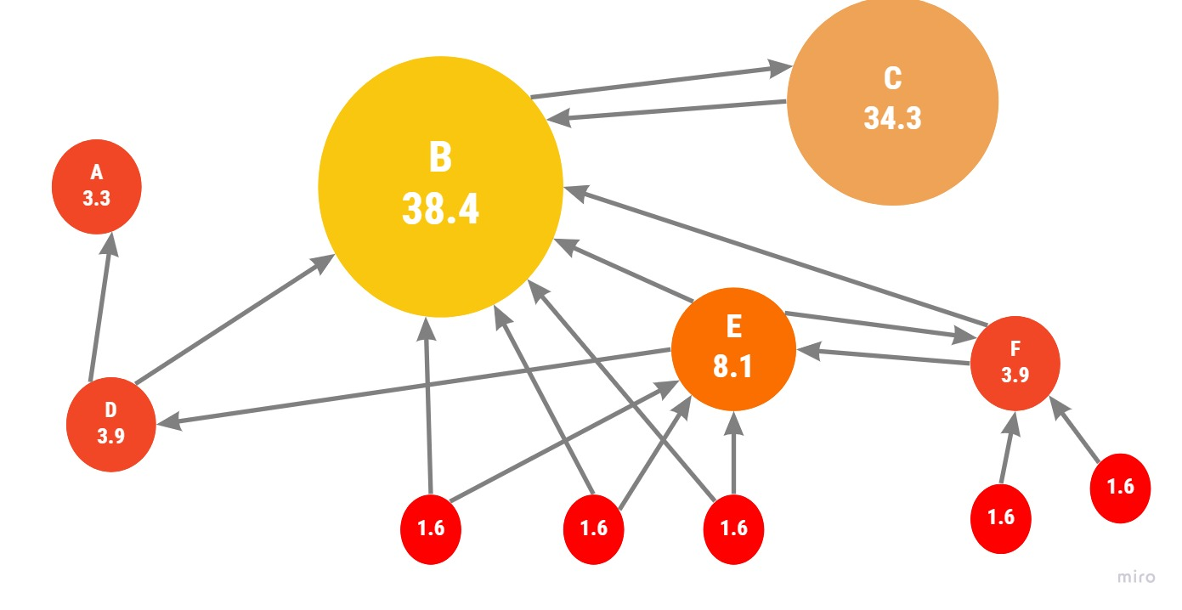
Graph Theory Applications
Graph Models help us model:
Local area networks
Computer networks
Algorithms
Ex. PageRank, which is used by Google search
PageRank

Slide 5
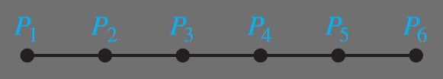
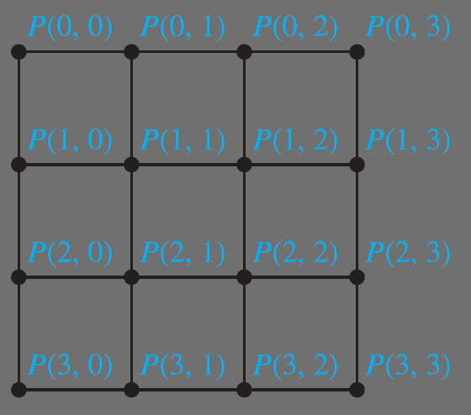
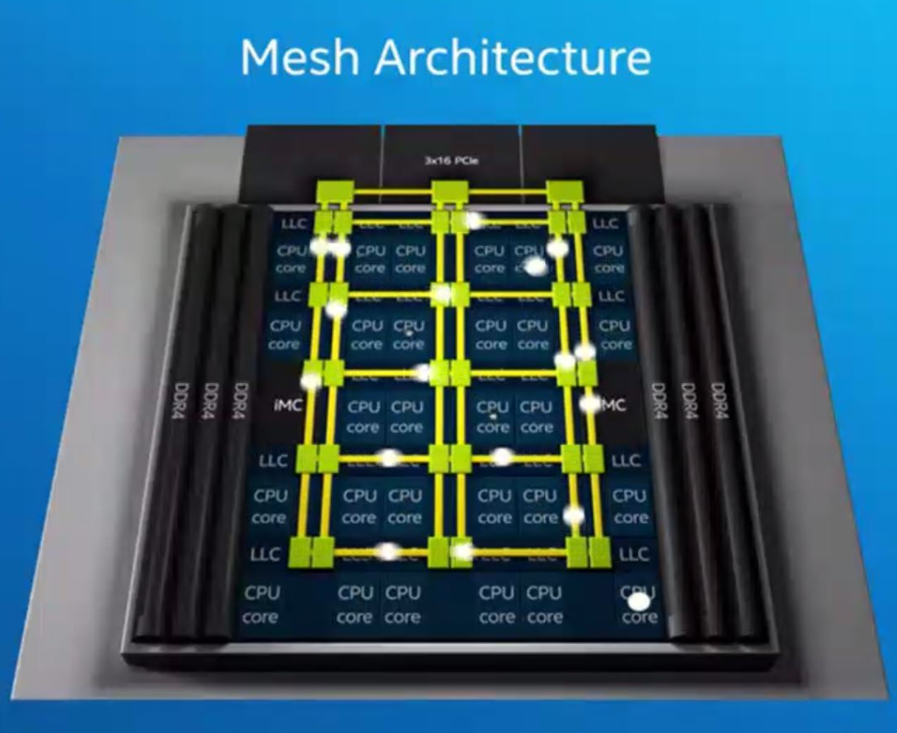
Example: Modeling Processors
Linear Array
Mesh Network

Slide 6

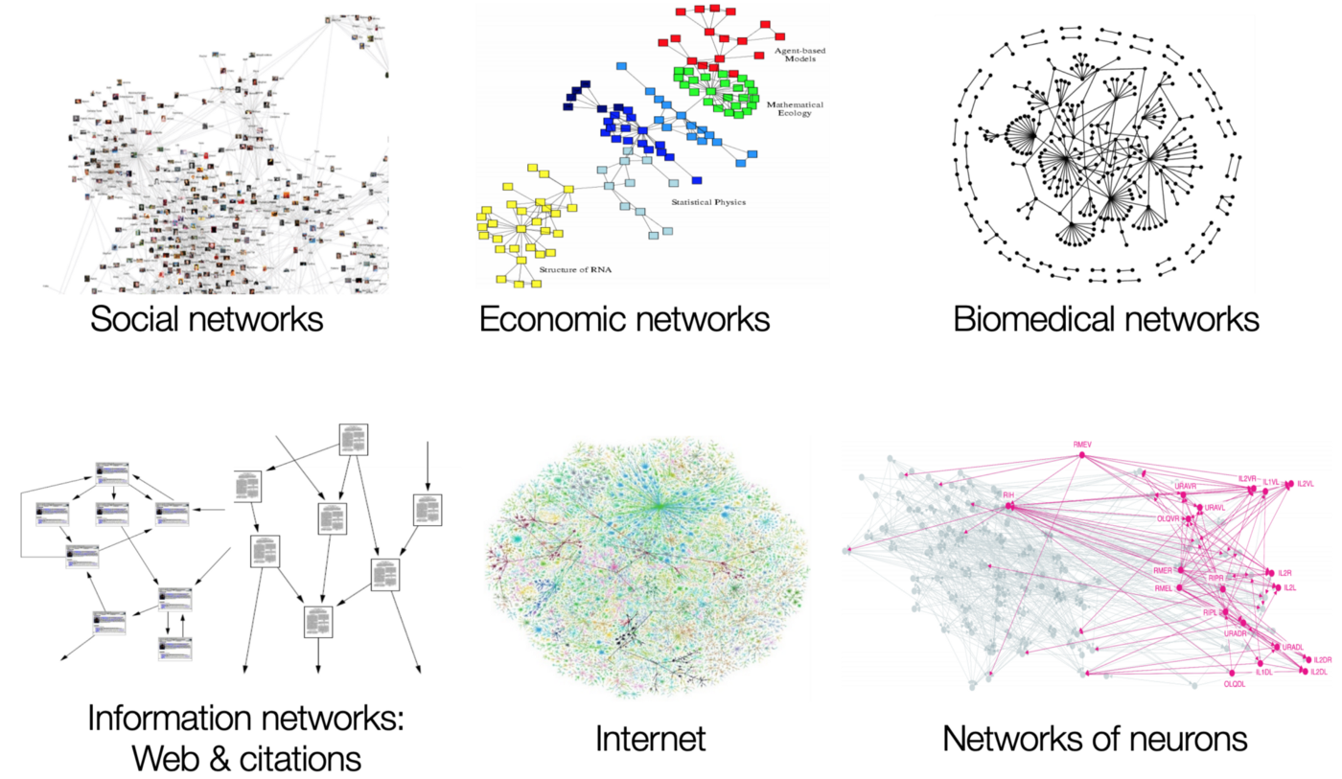

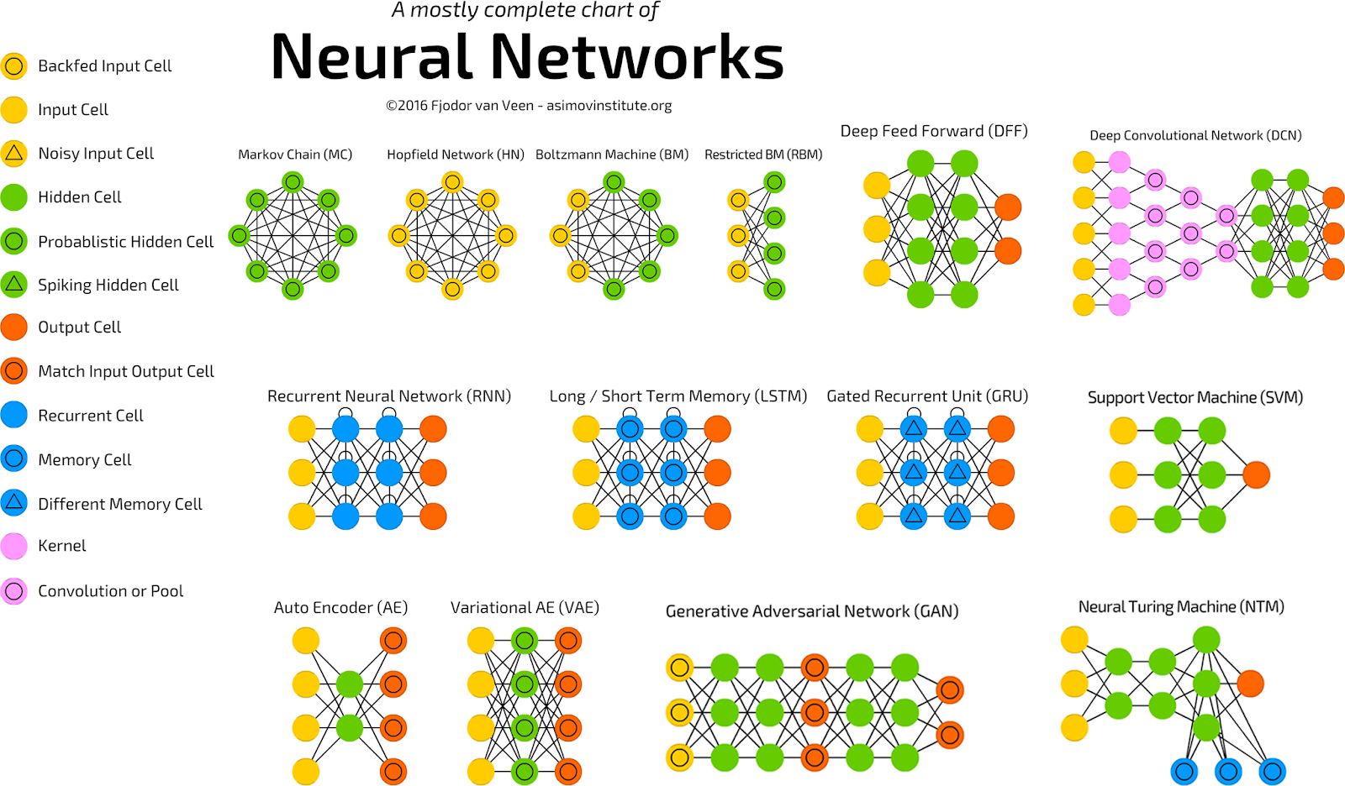
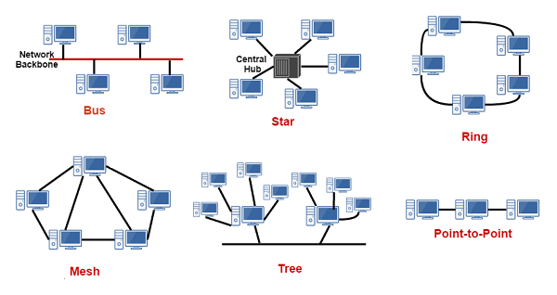
That was just the surface…
and much more…

Slide 7
Thanks for Watching

Slide 8
Works Cited
Discrete Mathematics and Its Applications 8th Edition by Rosen, Kenneth H.
https://scitechconnect.elsevier.com/vintage-multi-core-the-ipc/
https://www.xomnia.com/post/graph-theory-and-its-uses-with-examples-of-real-life-problems/

